Slide 1
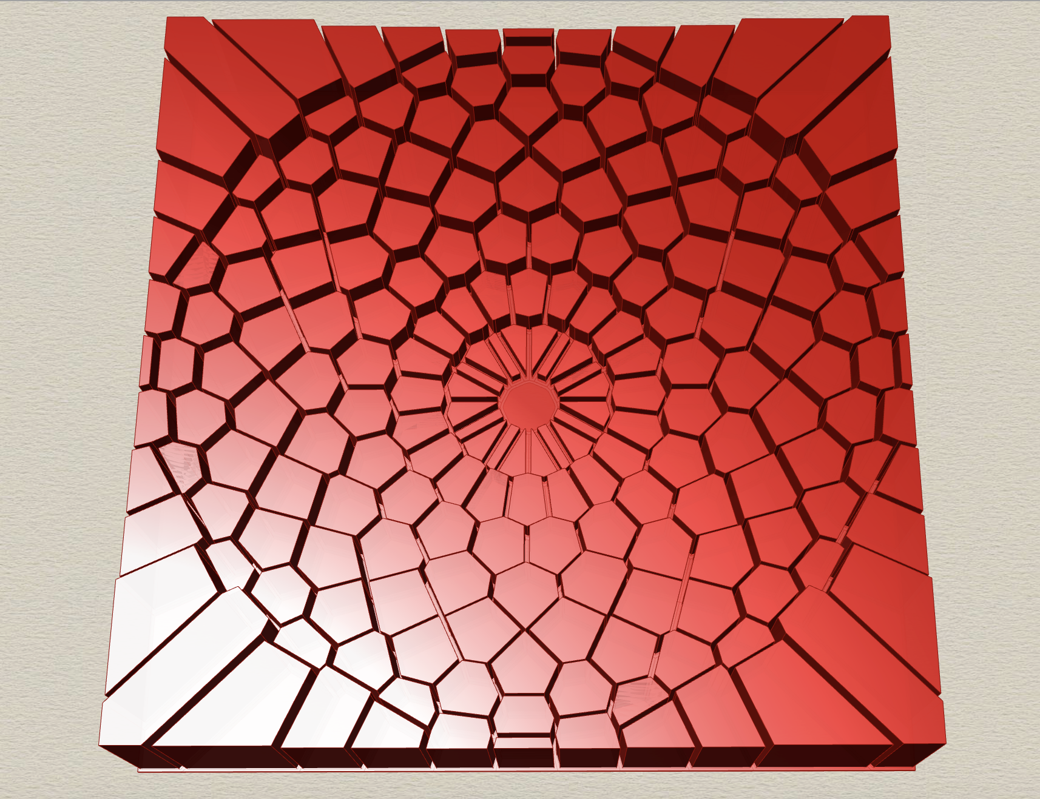
P1
<Computational Design Thinking>
<Parametric Design>
P1
BEST PICTURE
Assignment
Context
Course
Date
Parametric
Design
Freshmore
Term 1
Computational
Design Thinking
14 Oct 2024
Student
<Voronoi Crater>
My project presents a crater that is formed from dividing an n-sided polygon with lines. The pattern features a collection of polygonal shapes that are organized radially around a central point. Then, a cluster of Voronoi cells are generated using the midpoints of each of these lines to form a geometric pattern. Lastly, these cells are extruded in the z-axis by a magnitude proportional to the distance from the center of the tile, resulting in a distinctive crater effect.
Aaryan Shanbhag
1008768
Instructor
Geraldine Quek
Faculty Fellow

Slide 2
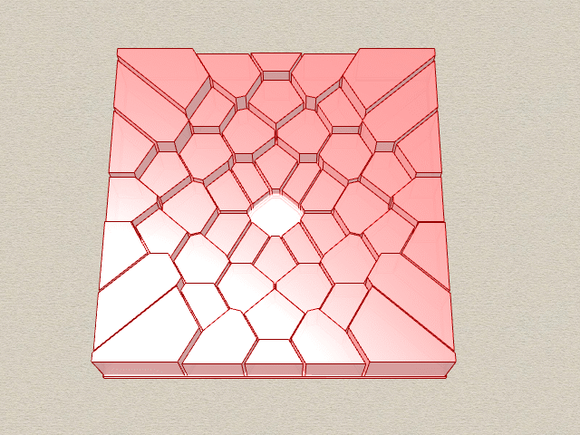
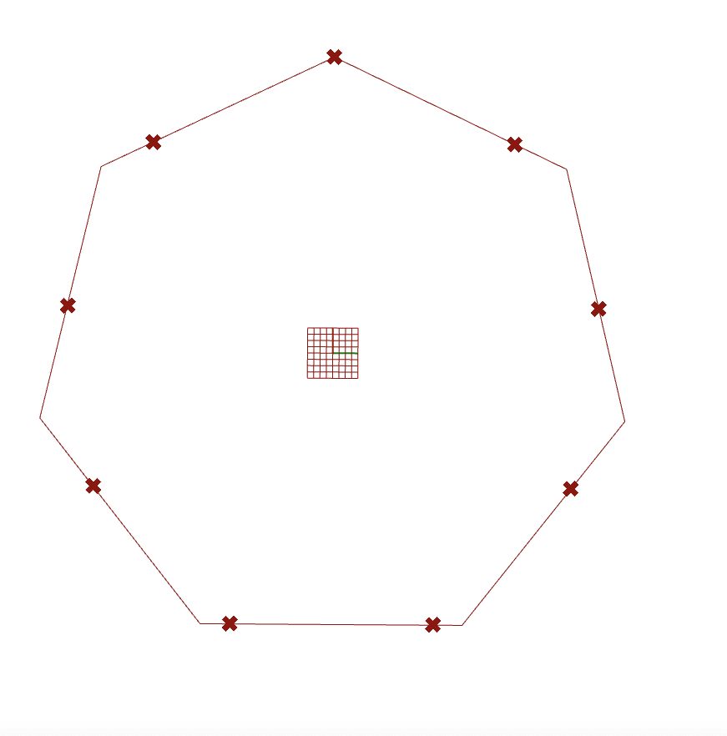
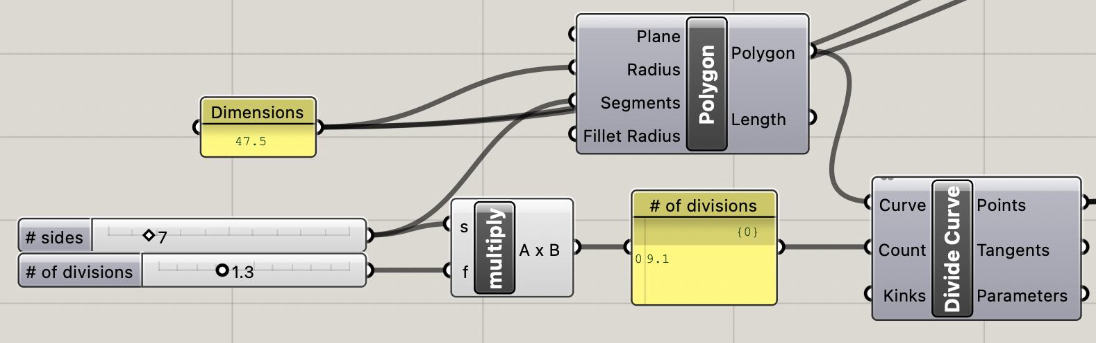
P2
<Computational Design Thinking>
<Parametric Design>
P2
References
<Parameters>
In the prototyping process, 2 different parameters are changed: the number of sides that the polygon has, given by n and a factor f with which the polygon is divided into, given by nf (rounded to the nearest integer). For example, 7-sided polygon with f set to 1.3 will be divided into 9 (= 7 x 1.3) different equidistant points along the perimeter of the pentagon. The f parameter adds a layer of aesthetic complexity to the pattern being generated. On the other hand, The n parameter changes qualitative aspects of the build. I will be evaluating my designs by setting parameters based on the following values:
n f
Low: 7 1.0
Mid: 9 1.3
High: 12 1.7
Animation of all integer n values from 6 to 12 with f set to 1.7 →
You may use this margin to link external sources used such as URLs, articles bibliography, footnotes, picture captions etc.
If you do not need to include any of the above then delete both the green text caption and this textbox.
7-sided pentagon divided into 9 different points →
Captions
01 Description
02 Description
01
02

Slide 3
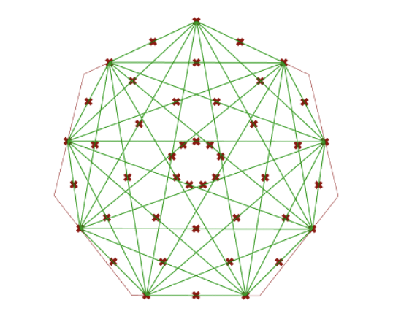
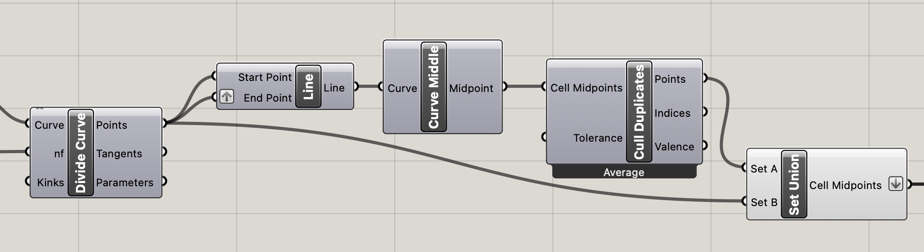
P3
<Computational Design Thinking>
<Parametric Design>
P3
References
<Generating Points>
The points are generated from joining all possible pairs of dividing points on an n-sided polygon with lines. This can be done by setting the dividing points as both the start and end of a line and using the ‘graft’ feature. Grafting restructures a list of items into a new data tree where each item is placed in its own separate branch. In simpler terms, it considers all possible permutations of two points defined along the polygon with which a line can be created. This is an essential step in forming the data landscape I will be using for my design.
Since the permutation of every possible pair of points identifies two different orders of the same points as two instances, there might be duplicate midpoints formed. Duplicates may also be formed in perpendicular lines which intersect at their midpoint. For this reason, the ‘Cull Duplicates’ component helps in removing all duplicates points before generating a Voronoi pattern. If these duplicates aren’t deleted from the data set Rhino may not generate the Voronoi pattern correctly or slow down the computer.
These points are then grouped together by the ‘Set Union’ component to output the cell midpoints. These cell midpoints will form the basis of Voronoi patterns. Note that it is important to flatten the cell midpoints as they are considered a single group, regardless of their original data paths.
While working on my project, I found that leaving the cell midpoints unflattened and being unaware of the duplicate points formed was one of the most challenging bugs that I fixed. Being able to resolve those bugs was a very satisfying experience.
You may use this margin to link external sources used such as URLs, articles bibliography, footnotes, picture captions etc.
If you do not need to include any of the above then delete both the green text caption and this textbox.
Lines formed using graft technique (in green).
Points formed by dividing the polygon and obtaining the midpoint of each of those divisions (in red).
Captions
01 Description
02 Description
01
02

Slide 4
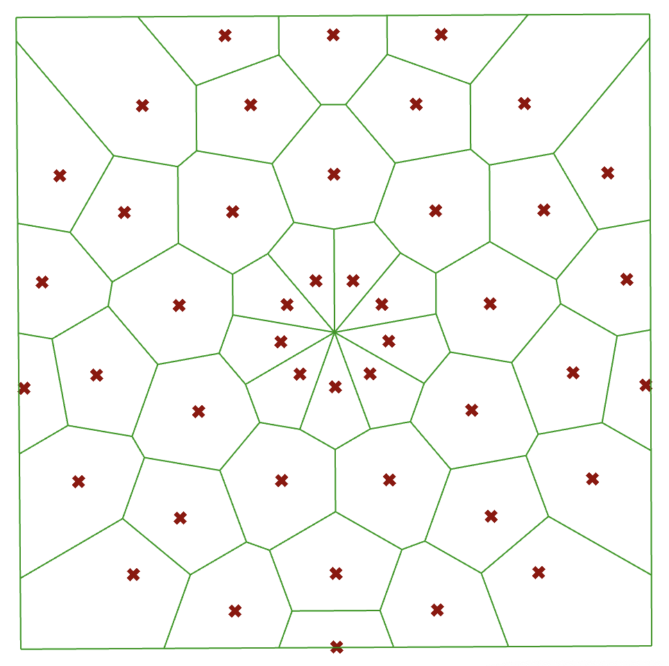
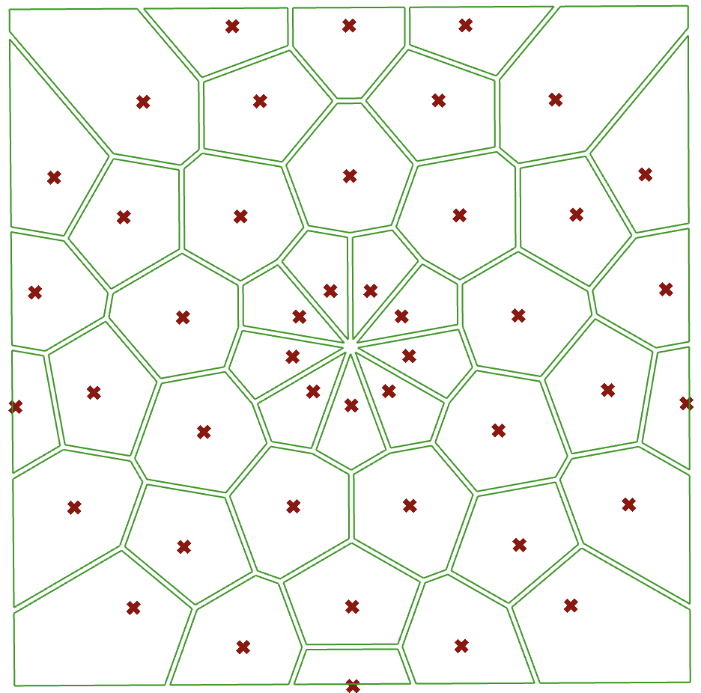
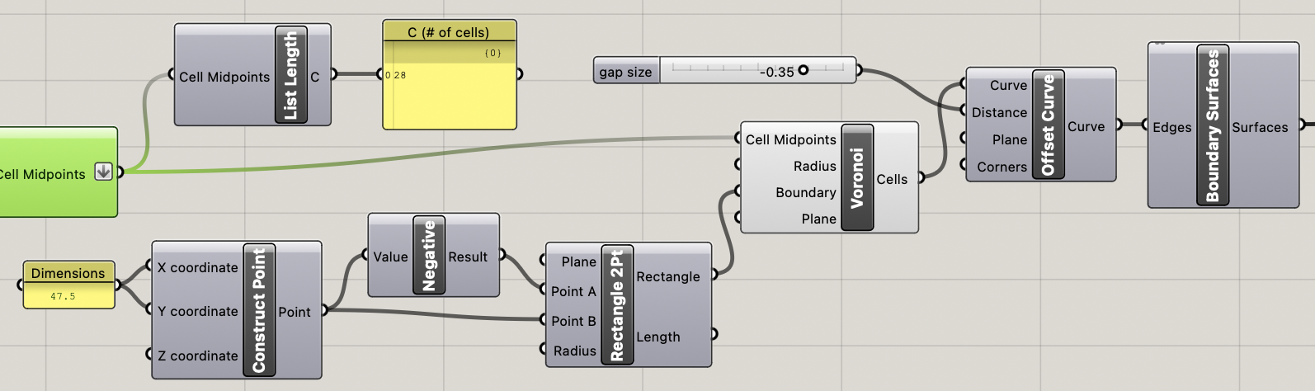
P4
<Computational Design Thinking>
<Parametric Design>
P4
References
<Creating Voronoi Patterns>
A Voronoi pattern is a way of dividing a space into regions based on a set of points, where each region contains all points that are closer to its corresponding seed point than to any other seed point.
There are two main variables that get input into the Voronoi component: the cell midpoint and the boundaries of the Voronoi pattern. The boundary value is based of a rectangle generated from 2 points (47.5, 47.5, 0) and (-47.5, -47.5, 0). This ensures that the build meets the required dimensions of 95 x 95.
Lastly the ‘Offset Curve’ component creates gaps in between each Voronoi Cell to give it the rugged effect. It takes ‘distance’ as one of its parameters which I’ve chosen to keep constant at a value of -0.35. These Curves are then plugged in to the ‘Boundary Surfaces’ block which turns the curves generated by the offset curve component into a cell of its own.
You may use this margin to link external sources used such as URLs, articles bibliography, footnotes, picture captions etc.
If you do not need to include any of the above then delete both the green text caption and this textbox.
Before Offsetting Voronoi →
← After Offsetting Voronoi
Captions
01 Description
02 Description
01
02

Slide 5
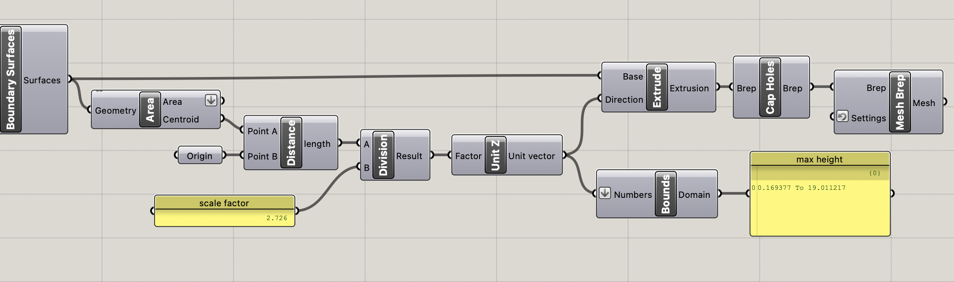
P5
<Computational Design Thinking>
<Parametric Design>
P5
References
<Extruding & Baking Tiles>
1. Boundary Surfaces: This component is generating surfaces, probably from input curves or other geometrical
data.
2. Area Component: It calculates the area and centroid of each surface generated by the Boundary Surfaces component. The centroid is used as a reference point for calculating the volume.
3. Distance Component: This calculates the distance between the cell midpoint (Point A) and origin (Point B).
4. Division Component: Takes the length calculated by the “Distance” component and divides it by a factor. The reason why it is divided by a scale factor is to ensure that it doesn’t exceed the maximum possible build height of 20mm. According to the ‘max height’ panel, the maximum height that the tile reaches is around 19.0mm.
6. Unit Z Component: This generates a unit vector in the Z direction, the magnitude of extrusion is based on the distance from the centre of the tile (origin) to the Voronoi cell midpoint.
7. Extrude Component: Uses the base surface or geometry, along with the Z-direction unit vector, to extrude the geometry to create a 3D form.
After Extruding, the ‘Mesh Brep’ component coverts the Brep to a Mesh and is then baked to form the final product.
You may use this margin to link external sources used such as URLs, articles bibliography, footnotes, picture captions etc.
If you do not need to include any of the above then delete both the green text caption and this textbox.
Captions
01 Description
02 Description
01
02

Slide 6
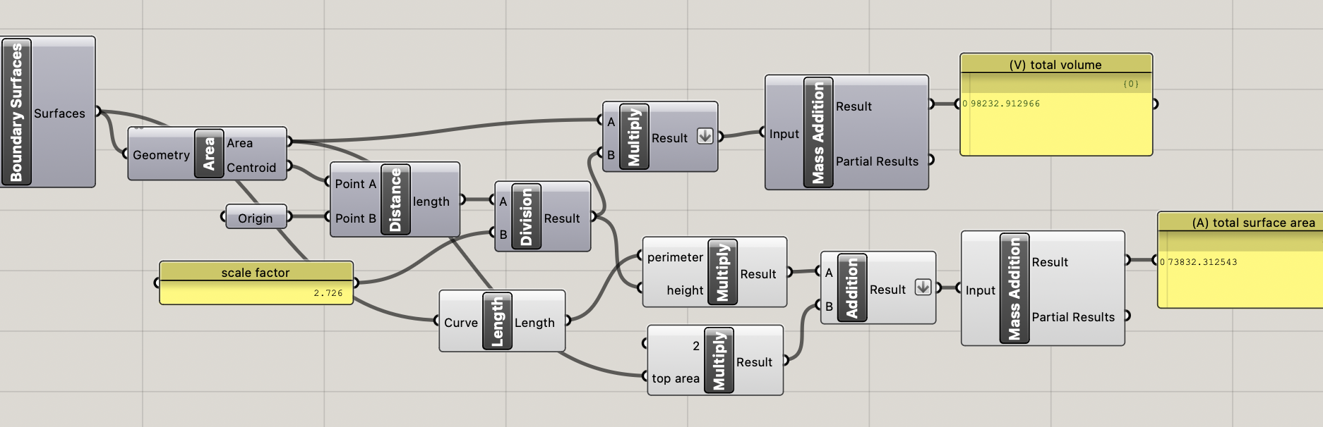
P6
<Computational Design Thinking>
<Parametric Design>
References
<Evaluation>
The resulting design is analyzed based of 2 criteria:
Desirability with an increase in complexity
Desirability with a decrease in volume
A lower build volume is desired as it helps in reducing production costs and time required for 3D printing my tile. Therefore, I chose to increase the number of segments my polygon has to achieve a sufficiently low build volume, while at the same time, not compromising the sophistication of my design.
For each design variation, I’ve measured the following variables:
V: Total volume of the build.
A: Surface area of each extrusion.
C: Number of cells.
Offset gap size and extrusion factor are set constant at -0.35 mm and 2.726 respectively.
P6
You may use this margin to link external sources used such as URLs, articles bibliography, footnotes, picture captions etc.
If you do not need to include any of the above then delete both the green text caption and this textbox.
Formulae →
a_cell = (2 * a_top) + (h * p_top)
v_cell = a_top * h
Where:
a_cell → total surface area of each cell (mm²)
v_cell → total tile volume of each cell (mm³)
a_top → area of each cell before extrusion (mm²)
p_top → perimeter of each cell before extrusion(mm²)
h → height (mm)
the a_cell and v_cell values of each cell are input
into the mass addition component to obtain the total surface area and volume respectively
Captions
01 Description
02 Description
02
01
03

Slide 7
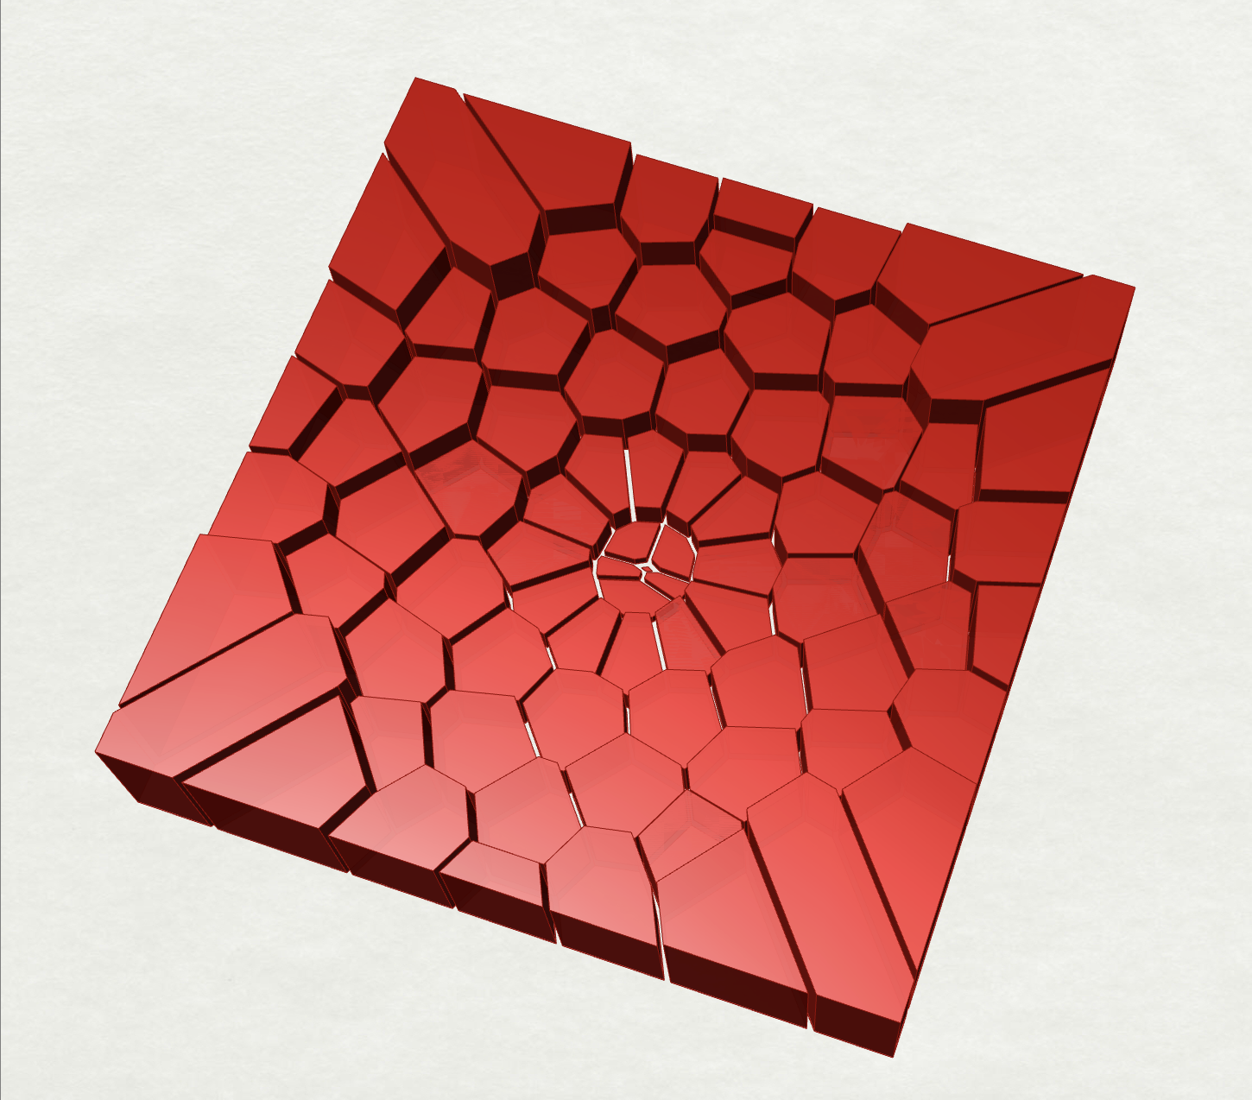
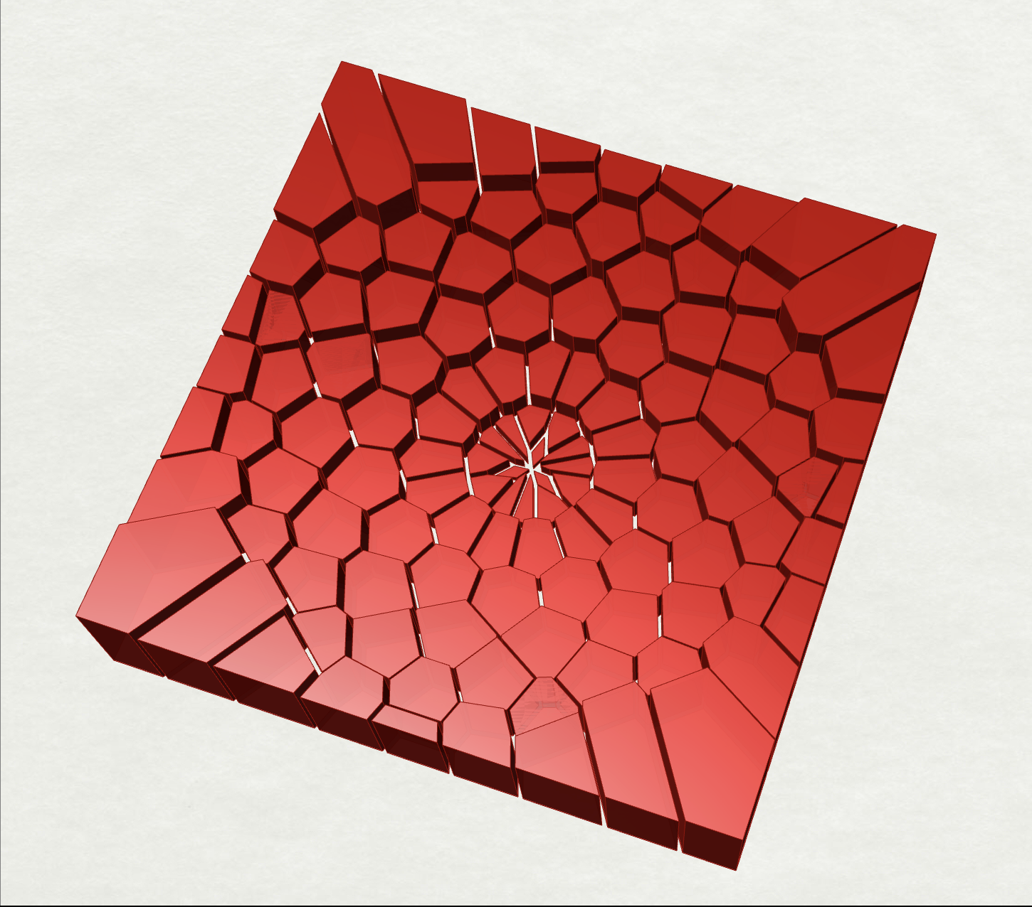
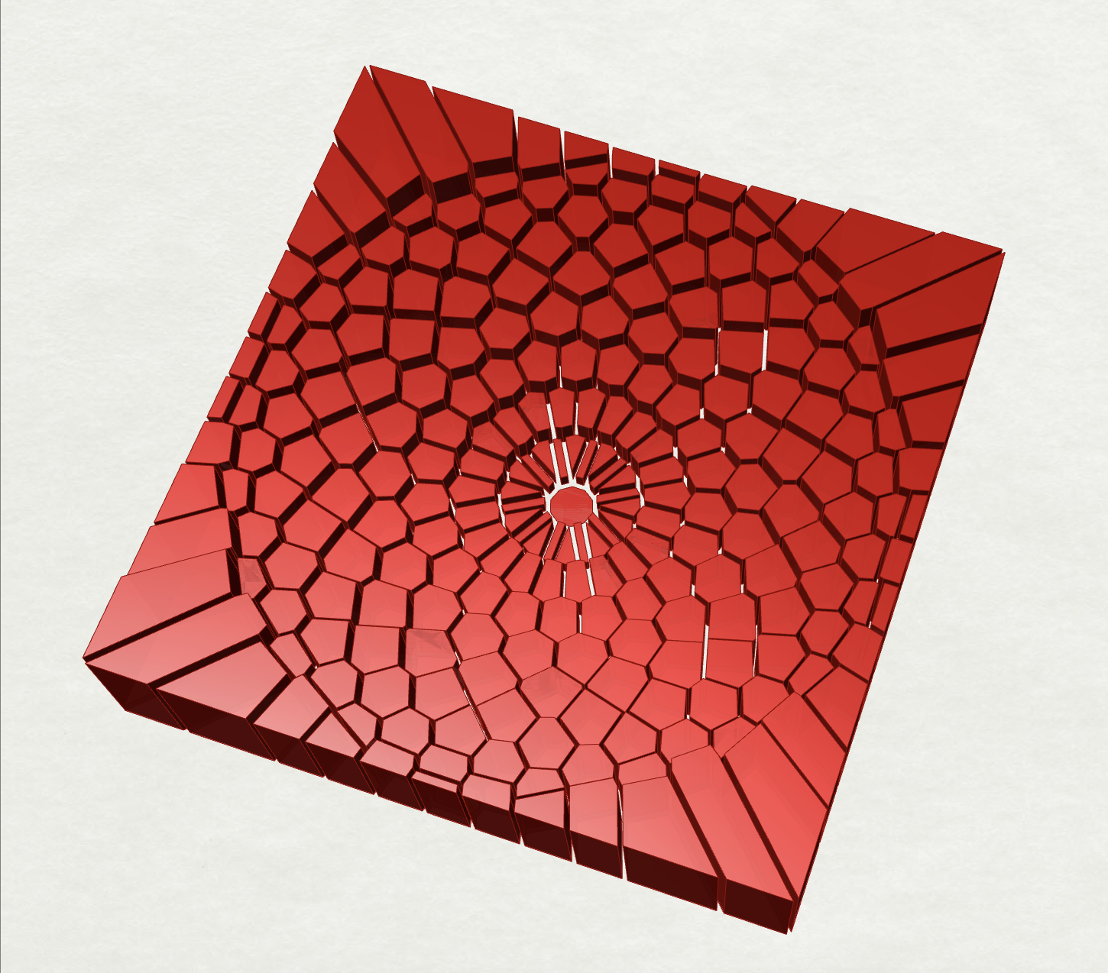
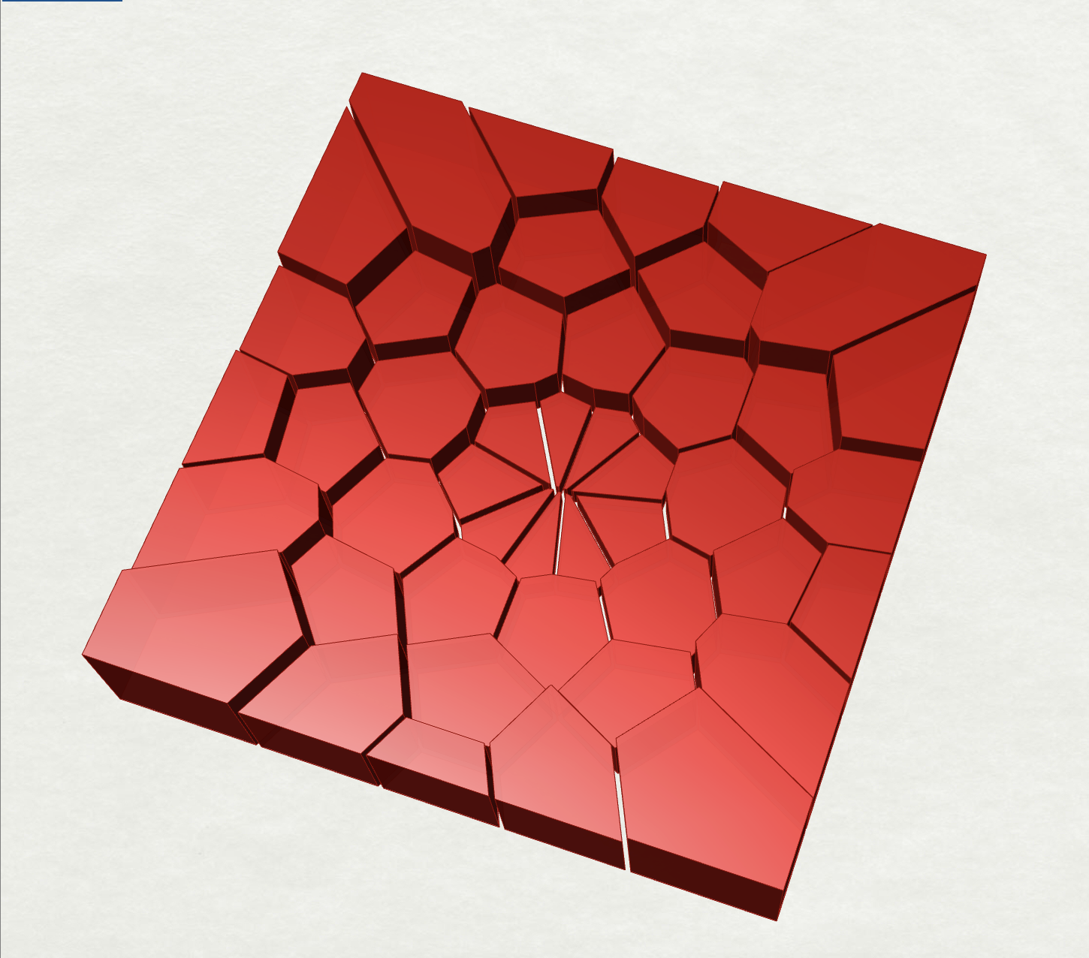
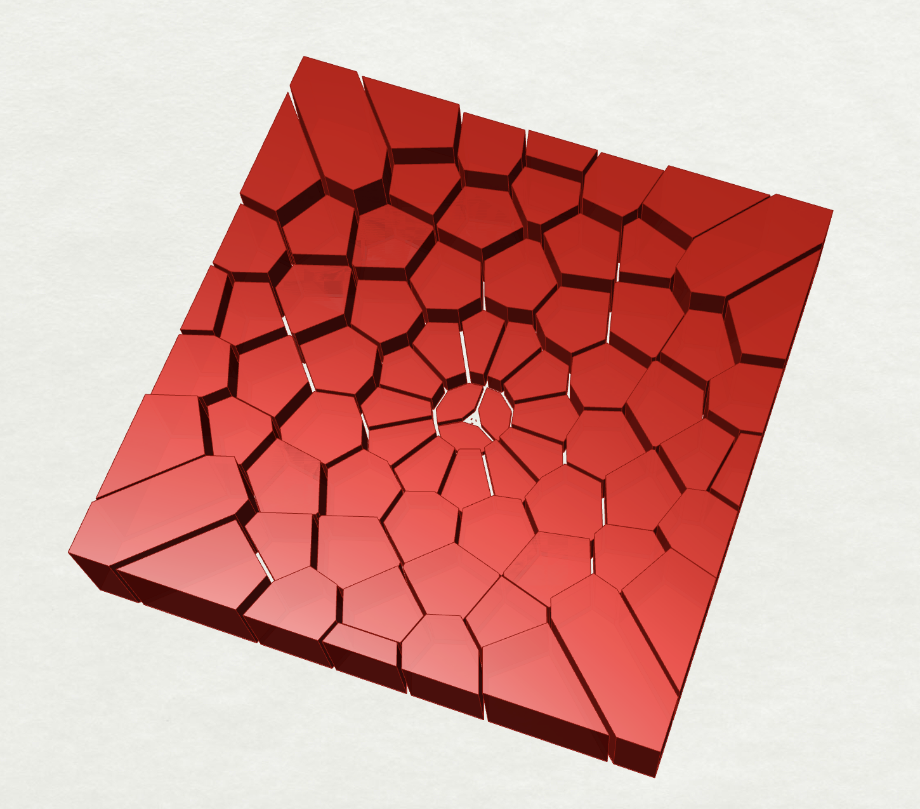
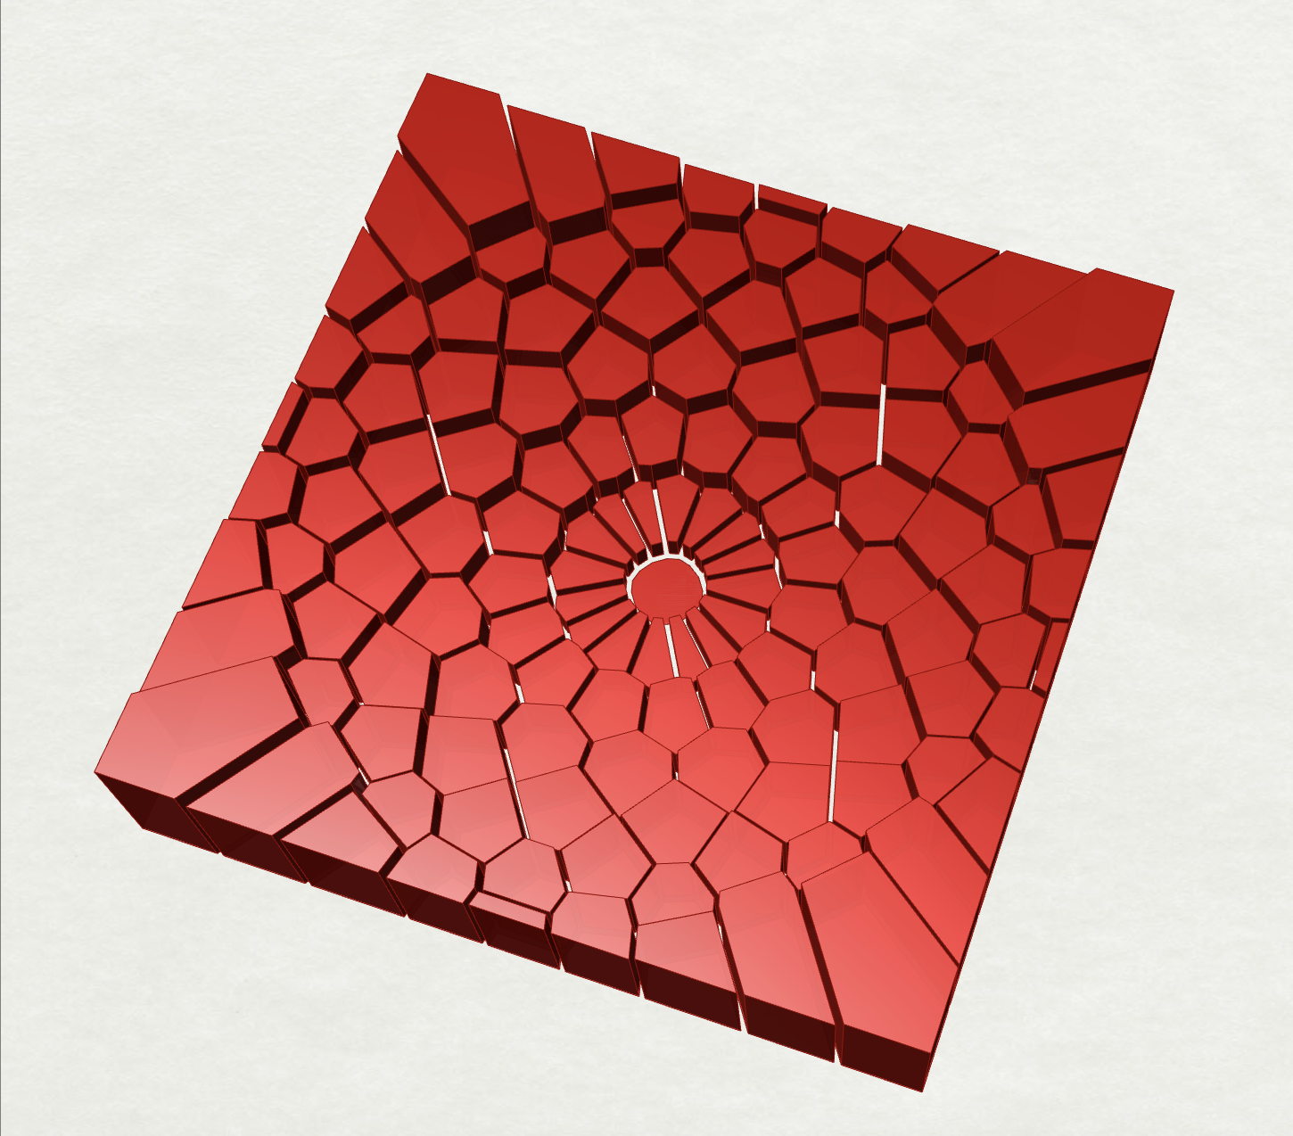
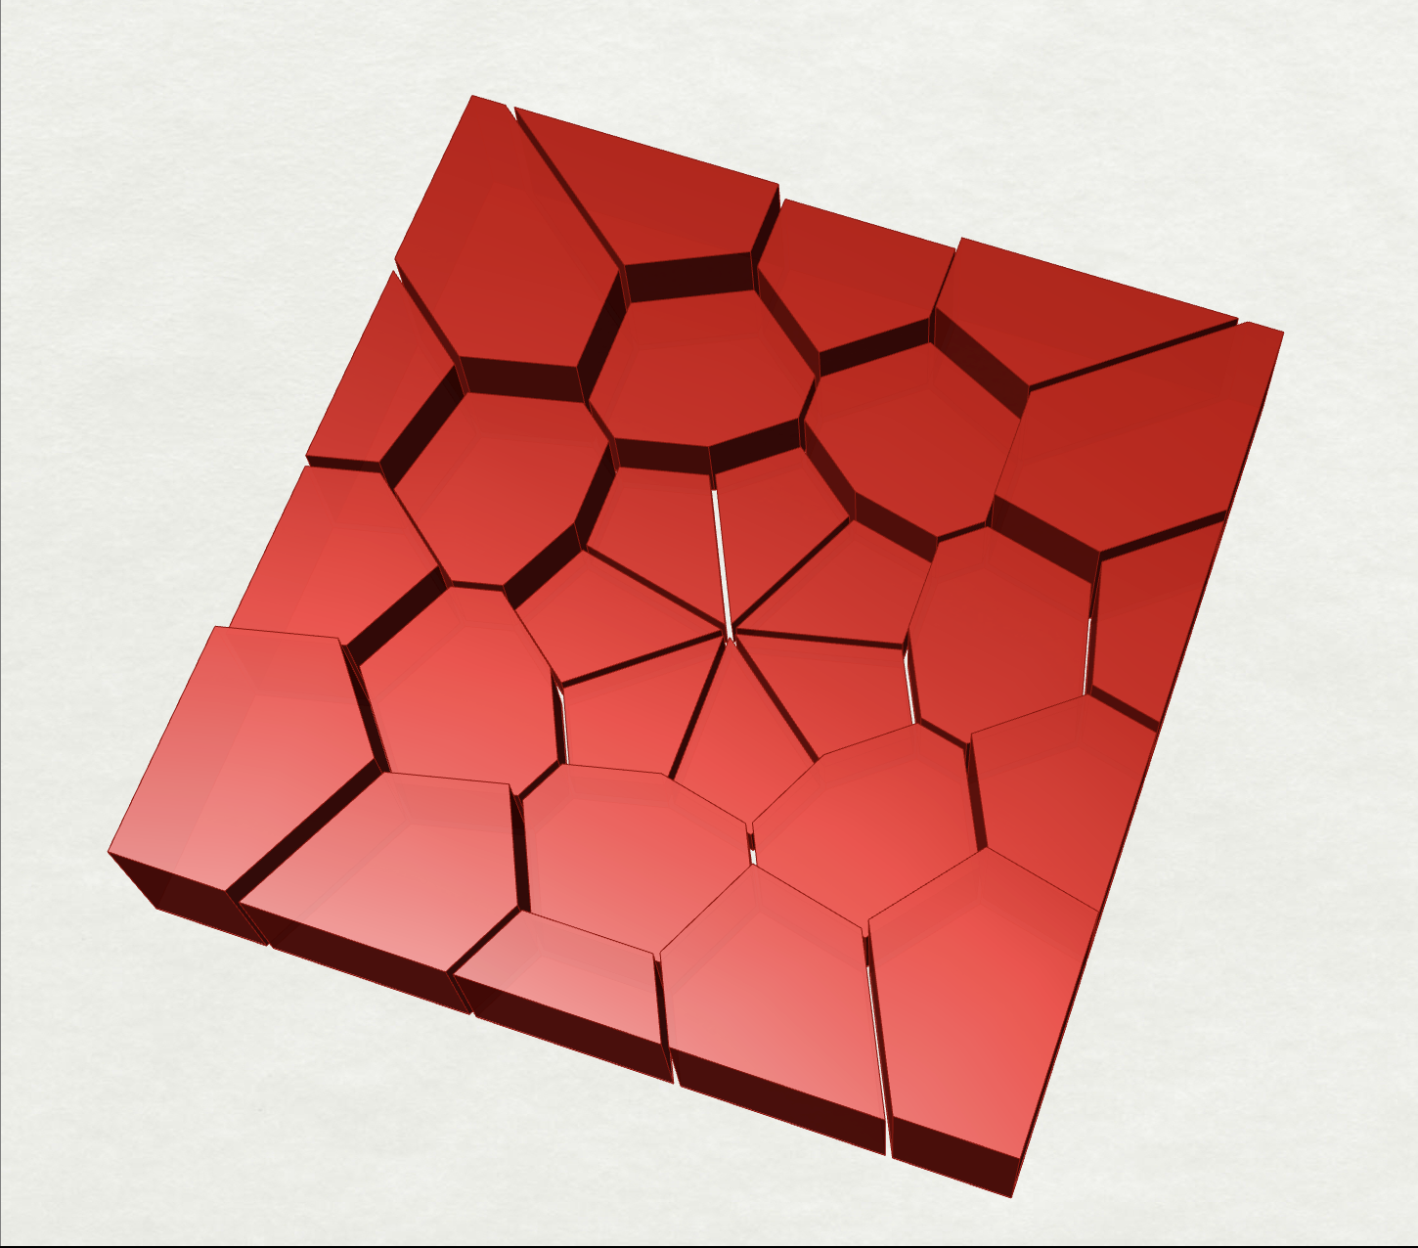
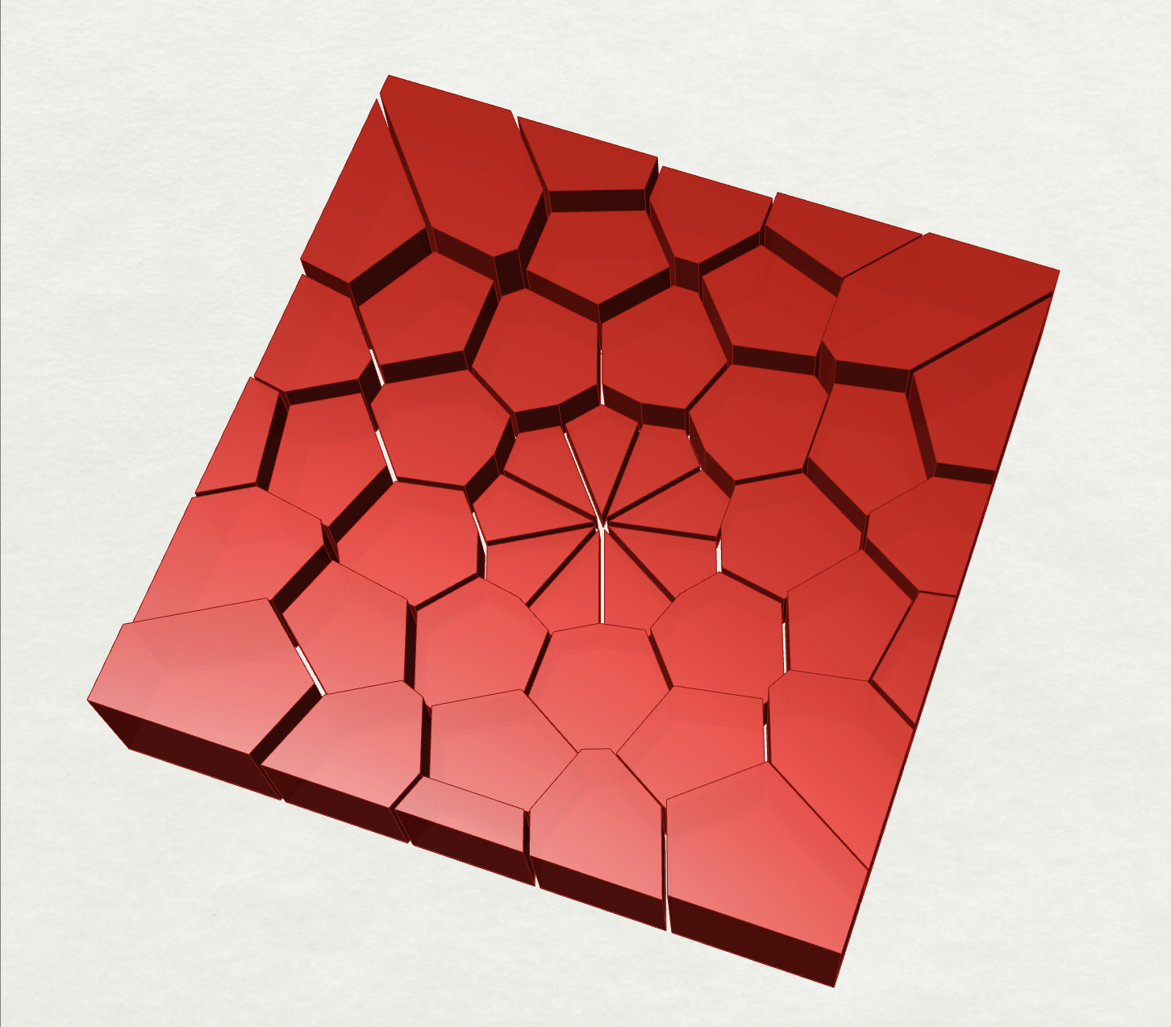

P6
<Computational Design Thinking>
<Parametric Design>
P6
<Variation Matrix>
FINAL DESIGN
f = 1.7
<Legend>
n: side count
f: polygon division factor
V: Volume
(in mm³)
A: Surface Area
(in mm²)
C: Cell Count
<Constants>
offset gap size
= -0.35 mm
extrusion factor
= 2.726
V: 106032 A: 53865 C: 78
V: 104131 A: 58973 C: 120
V: 98233 A: 73832 C: 201
Desirability (with increase in complexity)
f = 1.3
V: 107113 A: 45928 C: 45
V: 105916 A: 54133 C: 78
V:102181 A: 63921 C: 129
f = 1.0
V: 110056 A: 41104 C: 28
V: 108531 A: 46627 C: 45
V: 105581 A: 54641 C: 73
n = 7
n = 9
n = 12
Desirability (with decrease in volume)

